Slide 1
Rising National Tensions
1850-1860

Slide 2
Abolitionism
Spread in North
Frederick Douglass: runaway slave who became abolitionist leader
William Lloyd Garrison: editor of abolitionist newspaper, The Liberator
Underground Railroad: elaborate network of white abolitionists, free blacks and slaves (not only Harriet Tubman)
Total number of fugitives assisted by the UGR 1830-1860 was between 70,000 and 100,000

Slide 3
Compromise of 1850
California wanted to be a free state
The South had assumed it wouldn’t be and was upset it was
As a compromise, California would enter the Union as a free state with the condition that Utah and New Mexico would vote on slavery
Fugitive Slave Law – meant to appease South, many Northerners felt it turned them into slave-catchers

Slide 4
Kansas-Nebraska Act of 1854
Proposed by Stephen Douglas
People in Nebraska Territory would vote on whether to have slavery or not (popular sovereignty).
Sounded like a sound compromise, but it upset some anti-slavery forces
Freesoilers (poor farmers who couldn’t compete with slave-owners), and pro-slavery forces streamed in
Mini civil war: “Bleeding Kansas”

Slide 5
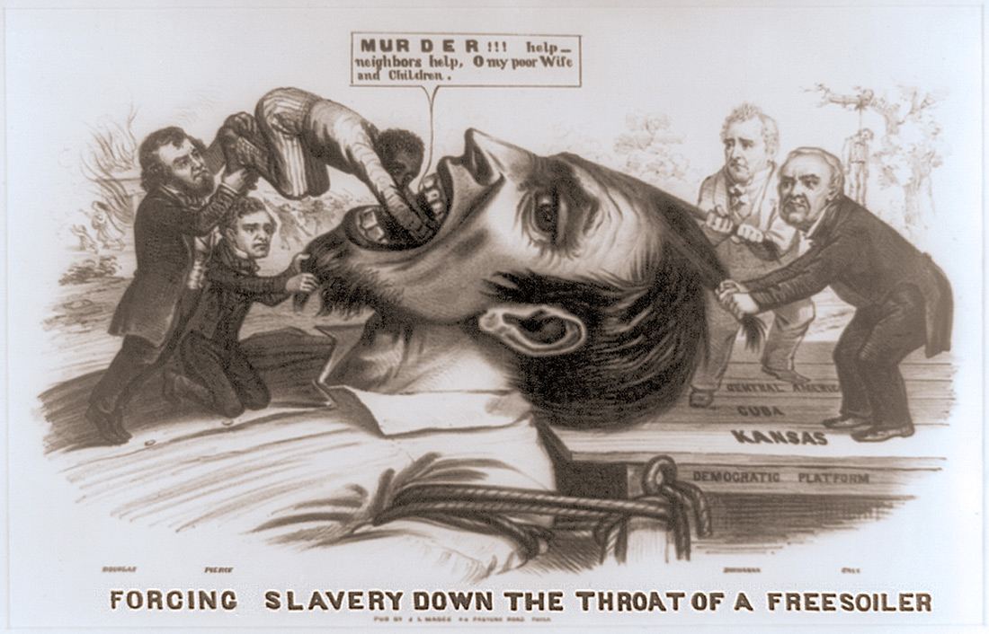
Political Cartoon, 1856

Slide 6
John Brown
Abolitionist
Involved in the Underground Railroad
Moved to Kansas to support the anti-slavery cause
Responded to violence by pro-slavery men by organizing the murder of 5 proslavery settlers: Pottowatomie Creek Massacre

Slide 7
John Brown’s Raid on Harper’s Ferry
Brown planned a raid on a federal arsenal
He wanted to distribute weapons to slaves
Action failed. Brown and his men were mostly captured or killed within 36 hours
Brown was ultimately hanged

Slide 8
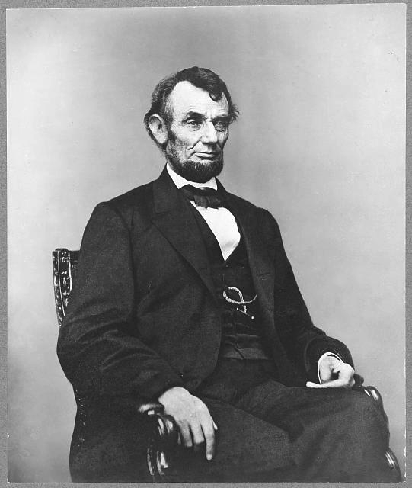
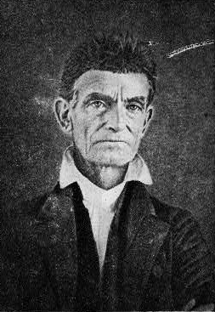
Abraham Lincoln called Brown a “misguided fanatic.”
Abraham Lincoln
John Brown

Slide 9
Central Historical Question:
Was John Brown a “misguided fanatic”?

